Slide 1

ECEN 3593-001 Computer Organization
Lecture #30
31 March 2021

Slide 2


Agenda
Class Announcements
Codasip Debugging
Hierarchical Memory

Slide 3
Class Announcements
Reading assignment for the week
“Computer Organization and Design, The Hardware / Software Interface, RISC-V edition,” by David Patterson and John Hennessy
ISBN 978-0-12-812275-4
Chapter 5, “Large and Fast: Exploiting Memory Hierarchy”
pages 364-410 (sections 5.1 thru 5.4)

Slide 4
Class Announcements
Phases 5 and 6 are in the deduction period – 1%/day
Phase 7 is in the deduction period – 4%/day
Pause extended through last Sunday, on all Phases
Phase 8 is posted
Target Date Sunday, April 4 at 10:00 PM
Bonus 1%/day, deduction 4%/day
Homework #4 is due Thursday, April 1 at 10:00 PM

Slide 5
Homework #4 Typos
Question 3 – Instruction Class C is 40% of the instructions, not 30%
Total must add to 100%
Question 5 – In the third part, the “40% increase” should be 30% to match the previous sentence.

Slide 6
Class Project
Don’t hesitate to use me as a resource
I can help you make major progress quickly – do not stay stuck
I will tell you if I don’t have time – don’t just assume that
DEBUG! And ask for help debugging!

Slide 7
Class Project
If Codasip skips over a statement when stepping:
The output of the statement is not connected to anything
So Codasip has optimized the statement out because it isn’t needed
Read the new Class Project Phase 8 – MEMCTL document
It has lots of information about what MEMCTL is doing and how to implement it

Slide 8
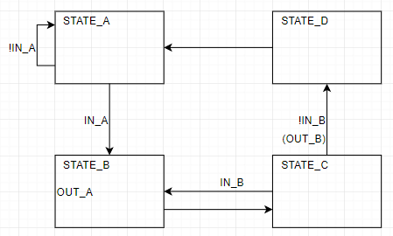
Phase 8 – State Machines
Consists of multiple States
Each a unique value of a “state register” or “state vector”
State changes on each clock, depending on the state and inputs
Some outputs purely a function of the state (a Moore machine)
Some outputs a function of the state and the inputs (a Mealy machine)

Slide 9
Phase 8 – State Machine Codasip Code
State register = r_me_state (next state = s_ex_state)
switch (r_me_state) {
case STATE_A:
s_ex_outa = 0;
s_ex_outb = 0;
if (!IN_A)
s_ex_state = STATE_A;
else
s_ex_state = STATE_B;
break;
case STATE_B:
s_ex_outa = 1;
s_ex_outb = 0;
s_ex_state = STATE_C;
break;
case STATE_C:
s_ex_outa = 0;
if (IN_B) {
s_ex_outb = 0;
s_ex_state = STATE_B; }
else {
s_ex_outb = 1;
s_ex_state = STATE_D; }
break;
case STATE_D:
s_ex_outa = 0;
s_ex_outb = 0;
s_ex_state = STATE_A;
break;
}

Slide 10
Phase 8 – State Machine Codasip Code
The previous is a canonical form – other approaches are possible
Use if/else instead of a switch
Combine state value and inputs in a single if statement
The outputs may cause something to happen that can be placed within the machine
For example, if OUT_A should save the value of IN_X in r_me_regx
if (r_me_outa == 1) s_ex_regx = s_ex_inx;
Else s_ex_regx = r_me_regx;

Slide 11
Class Project
Questions??

Slide 12
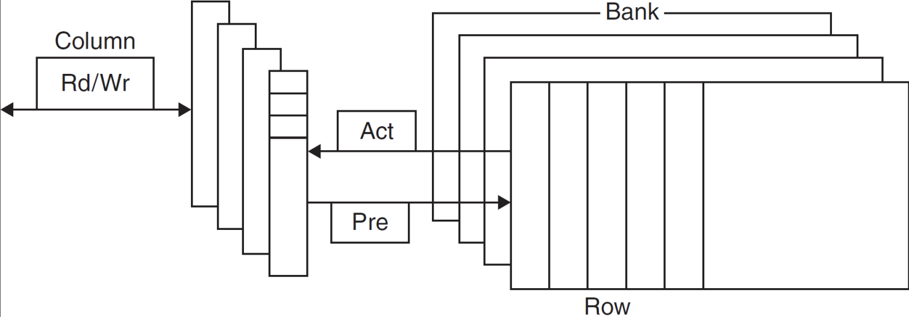
DRAM Technology
Data stored as a charge in a capacitor
Single transistor used to access the charge
Must periodically be refreshed
Read contents and write back
Performed on a DRAM “row”

Slide 13
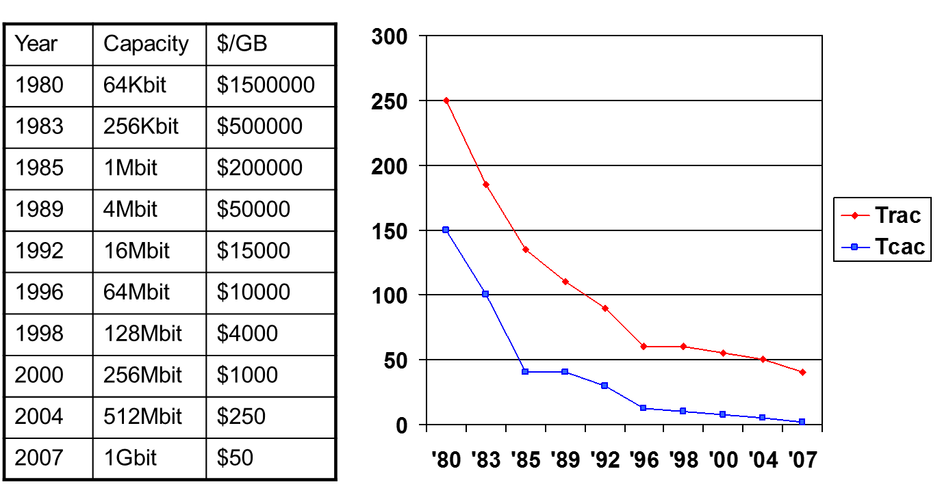
DRAM Generations
Example of Moore’s Law
Computers have Designed for Moore’s Law by developing processors and applications that can take advantage of this additional DRAM

Slide 14
DRAM Performance Factors
Row buffer
Allows several words to be read and refreshed in parallel
Synchronous DRAM
Allows for consecutive accesses in bursts without needing to send each address
Improves bandwidth
DRAM banking
Allows simultaneous access to multiple DRAMs
Improves bandwidth
Performance via Parallelism
Make the common case fast
Performance via Parallelism
And Designing for Moore’s Law

Slide 15
SRAM Technology
Data stored on a stable digital structure
4 to 6 transistors per bit
No refreshing necessary
Still has a row/column structure
Uses multiplexors for reading
Uses decoders for writing select words
Register File is a small example
Much faster than DRAM

Slide 16
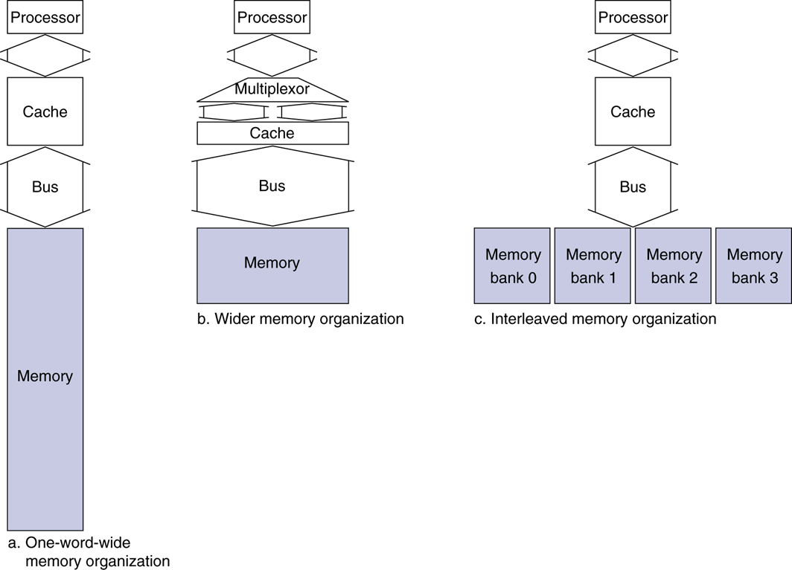
Increasing Memory Bandwidth
Memory access = 15 cycles
Miss penalty = 1 + 15 + 1 bus cycles
Bandwidth = 4 bytes/17 cycles = 0.23 B/cycle
4-word wide memory
Miss penalty = 1 + 15 + 1 = 17 bus cycles
Bandwidth = 16 bytes / 17 cycles = 0.94 B/cycle
4-bank interleaved memory
Miss penalty = 1 + 15 + 4×1 = 20 bus cycles
Bandwidth = 16 bytes / 20 cycles = 0.8 B/cycle

Slide 17

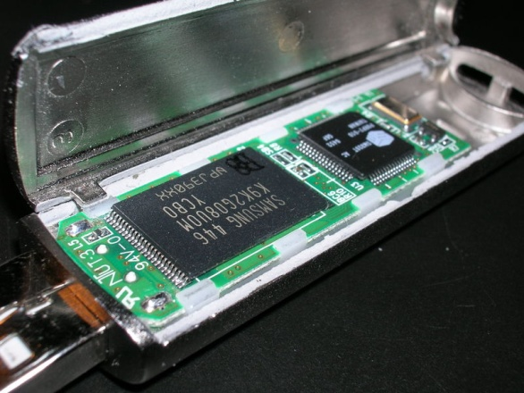
Flash Storage
Non-volatile semiconductor storage
100× – 1000× faster than disk
Smaller, lower power, more robust
But more $/GB (between disk and DRAM)

Slide 18
Flash Types
NOR flash: bit cell like a NOR gate
Random read/write access
Used for instruction memory in embedded systems
NAND flash: bit cell like a NAND gate
Denser (bits/area), but block-at-a-time access
Cheaper per GB
Used for USB keys, media storage, …
Flash bits wear out after 1000’s of accesses
Not ideally suitable for direct RAM or disk replacement
Wear levelling: remap data to less used blocks

Slide 19
Differences between NOR and NAND Flash
NOR
Quick random access to any memory location
100% known good bits for the life of the part
Good for direct code execution
Fast program and erase cycles
Density: 1Mbit – 2Gbit
Larger cell and more expensive
NAND
Slow initial access read access, then faster sequential reads
98% bits are good when new and additional bits fail over time (ECC is required)
Good for data storage
Slower program and erase cycles
Density: 128Mbit – 1Tbit
Smaller cell and less expensive
SLC, MLC, TLC, 3d technologies

Slide 20

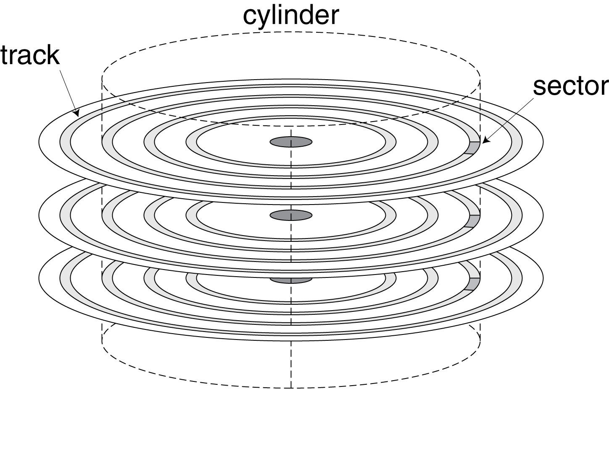
Disk Storage
Nonvolatile, rotating magnetic storage

Slide 21
Seagate’s Solid State Hybrid Technology
Merges the technology of HDD and SSD to provide near SSD performance at near HDD pricing
Memory Hierarchy used to accomplish this
Utilizes a small amount of NAND as cache memory to provide quick access to most common files
Actually, the NAND memory is a cache memory between the DRAM cache and the HDD
Access to the NAND cache files occurs at SSD speeds, but at a much lower cost

Slide 22
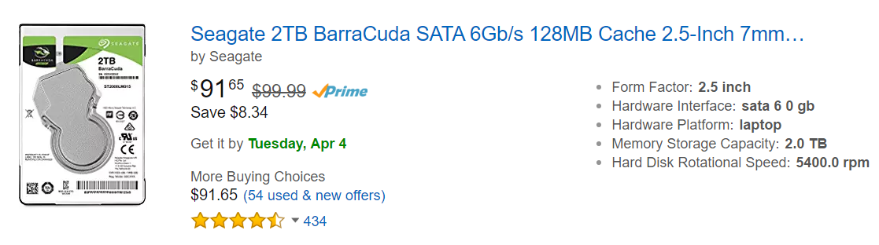
Seagate’s HDD

Slide 23
Cache Memories
Cache: a safe place for hiding or storing things (Webster’s New World Dictionary of the American Language, Third College Edition 1988)
Caches are a key to the scheme of Memory Hierarchy based on the following principles:
Temporal locality: the principle stating that if a data location is referenced, then it will tend to referenced again soon.
Example are the instructions in a loop
Spatial locality: the principle stating that if a data location is referenced, data locations with nearby addresses will tend to be referenced soon.
Example are the elements in an array

Slide 24
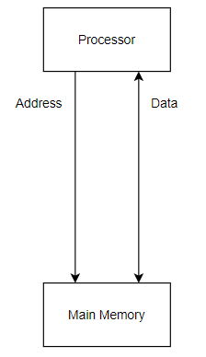
Cache Overview
Without a cache, the processor accesses memory as we see in Phase 8
Calculate an address as (base register + address offset)
Supply the address to memory
Data is transferred from the processor to memory on a write (store)
Data is transferred from memory to the processor on a read (load)

Slide 25
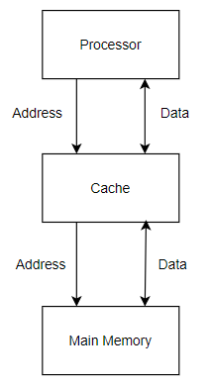
Cache Overview
A cache is added between the processor and memory
Processor supplies the same address to the cache
Cache determines if it contains the desired data
If it does (a HIT), data is transferred between the cache and the processor
If it doesn’t (a MISS), the cache creates a (possibly different) address and sends it to memory
Some (possibly different) data is transferred between memory and the cache
The original data transaction is completed

Slide 26
Cache Related Terms
Block (or line): the minimum unit of information that can be either present or not present in a cache
Equates to the minimum unit of information that must be transferred between the cache and memory on a cache miss
Hit rate: the fraction of the memory access found in a level of memory hierarchy
Hit time: the time required to access a level of memory hierarchy, including the time needed to determine whether the access is a hit or miss
Example:
Cache hit: 1 cycle to determine cache hit and cache access
Memory hit: 8 cycles for the first word and 2 cycles for each subsequent word in the block/line from memory (assuming all accesses to memory are a hit)

Slide 27
Cache Related Terms
Miss rate: the fraction of memory accesses not found in a level of the memory hierarchy
Miss rate = (1 – hit rate)
Miss penalty: the time required to fetch a block into a level of the memory hierarchy from a lower level, including the time to access the block, transmit it from one level to the other, insert it in the level that experienced the miss, and then pass the block to the requestor
Example: upon a cache miss, there is a cache penalty of 8 cycles for the first word of the block/line and 2 cycles for each subsequent word

Slide 28
Cache’s The BIG Picture
Caching is perhaps the most important example of one of of the Eight Great Ideas of Computer Architecture: Performance via Prediction
Memory hierarchies take advantage of temporal locality by keeping more recently accessed items closer to the processor, such as the cache
Memory hierarchies take advantage of spatial locality by moving blocks consisting of contiguous words in memory to upper levels of the hierarchy
Would a cache block of 1 or 4 take better advantage of spatial locality? (Poll)
If the hit rate is high enough, the memory hierarchy has an effective access time close to that of the highest/fastest level and equal in size to that of the lowest/largest level
In most systems, the memory is a true hierarchy in that the data cannot be present in level i unless it is also present in level i+1

